Slide 1





Machine learning techniques for predicting the properties of ceramic products
Pedro Domingues
Petia Georgieva
Institute of Telecommunications/Institute of Electronics and Informatics Engineering of Aveiro/Department of Electronics, Telecommunications and Informatics, University of Aveiro, 3810-193 Aveiro, Portugal

Slide 2
Introduction and Motivation
Corbário motivated (ask what phrase was)
Laboratory trial and error costly and timely
Reduce number of laboratory trials

Slide 3
Dataset
230 ceramic formulations
7 raw materials each with 11 features
4 target features (Aluminum Oxide(Al₂O₃), Iron(III) Oxide (Fe₂O₃), carbon and dry-to-fired shrinkage
Most of the ceramic formulations don’t include all the raw materials leading to a high number of zeros

Slide 4
ML Models: Linear Regression vs Neural Network
Linear Regression
Simpler Model
One target predicted at a time.
Predicted for:
Features with correlation bigger 0.1
First 3 raw materials
Direct features (Using Al₂O₃ to predict Al₂O₃, Fe₂O₃ to predict Fe₂O₃ and Carbon to predict Carbon)
Neural Network
More robust model
All targets predict at the same time
Predicted for:
All features
5 raw materials (excluding most zeros instead of converting them to a small value)
Most used raw materials
Direct features and their percentage of usage for the 7 raw materials
Direct features and their percentage of usage for the 5 raw materials

Slide 5
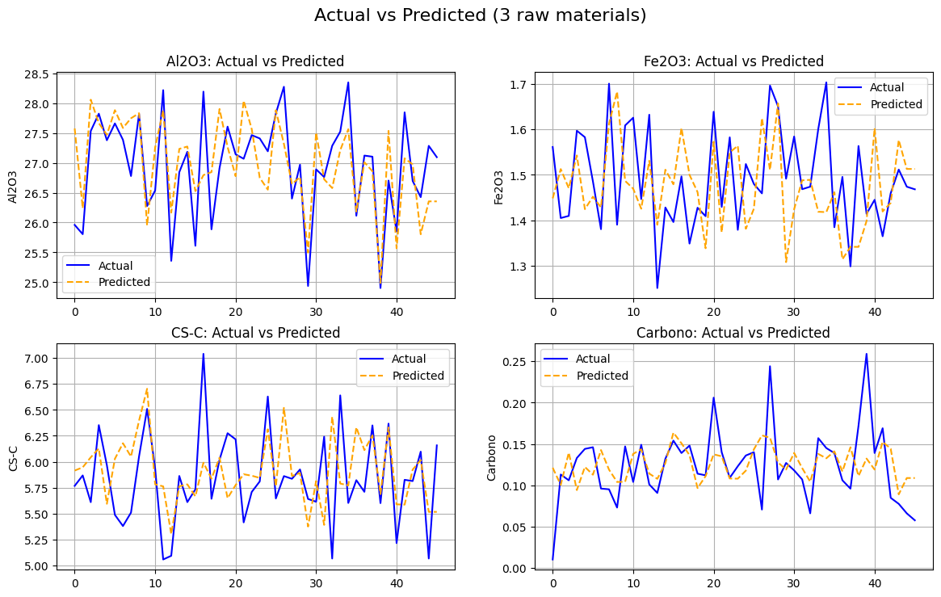
Results for linear regression
Features | Target | MAE | MSE | R²
Corr > 0.1 | Al₂O₃ | 0.486114 | 0.351496 | 0.496937
3 raw materials | Al₂O₃ | 0.514595 | 0.405854 | 0.419139
Al₂O₃ only | Al₂O₃ | 0.572654 | 0.507638 | 0.273466
3 raw materials | Carbon | 0.030292 | 0.001731 | 0.11239
D-F Shrinkage only | D-F Shrinkage | 0.343777 | 0.182973 | 0.015371
Carbon only | Carbon | 0.032272 | 0.001955 | -0.002301
Corr > 0.1 | Carbon | 0.032283 | 0.001976 | -0.013284
3 raw materials | D-F Shrinkage | 0.346842 | 0.209531 | -0.127547
Fe₂O₃ only | Fe₂O₃ | 0.097849 | 0.014264 | -0.248736
3 raw materials | Fe₂O₃ | 0.102115 | 0.015396 | -0.34779
Corr > 0.1 | Fe₂O₃ | 0.109827 | 0.019705 | -0.724988
Corr > 0.1 | D-F Shrinkage | 0.518506 | 0.425968 | -3.150945

Slide 6
Results for neural networks
Features | MSE | MAE | R²
Related features 7 raw materials | 0.285683 | 0.263759 | 0.998125
All features | 0.269828 | 0.305901 | 0.997691
Related features 5 raw materials | 0.679531 | 0.430052 | 0.995540
All Features | 0.815669 | 0.485576 | 0.993019
3 raw materials | 1.710167 | 0.664238 | 0.985364

Slide 7
Takeaways
Neural networks proved capable of predicting ceramic properties
Potential to help streamline production
Future work
More data preprocessing
New data to test this models on
Acknowledgements
Corbário – Industrial Minerals for providing the dataset

